Slide 1

EXL Solution for Ekaterra
March 17th 2022

Slide 2




Our understanding of your requirements from this program
Scalable operation focused on delivering superior customer experience
Deliver Omni Channel view across geographies with strong in Customer Satisfaction and delivery
Move to Digital / Transformation lead operating model embedded with Analytics
Data Led intelligence to drive better business decisions

Slide 3
Executive Summary of EXL Proposal
Agility. Digital Strong. Strong performance. Risk mitigation. Clear continuous improvement. Strategic alignment. Cultural affinity
We’ll put your customers, growth, performance, compliance priorities first, ensuring a culture of mutual respect and collective ownership. There’s no ‘you’ and ‘us’. It’s ‘we’: working together at all levels.
Solution Summary
Keeping requirements for language diversity and coverage window in mind, EXL proposes a total of 56 FTEs providing voice support for 15-16 languages as well as chat support for all languages using a digital translation solution
We believe that considering the volumes in all non-English languages, there is an opportunity be creative in solving for other languages with more flexible service standards and other digital solutions. Keeping that in mind, we have proposed an alternative solution approach as well as another approach that can be implemented in the long term and drive cost optimization while still meeting coverage requirements
While we are open to a Transaction-based pricing construct, we will need more conversations and clarity on capabilities that EXL will need to provide versus Ekaterra-provisioned to formulate an appropriate pricing at the case level
After evaluating multiple delivery locations globally, we propose a Primary/Secondary delivery construct based out of Pune and Noida, India
We have outlined two solution delivery approaches for the CRM solution. We would like to seek your inputs before formulating the final approach
Our proposed solutions includes various security controls to be embedded as part of the technology solution design, by complementing existing defense in-depth on premise controls with next gen Technologies to mitigate emerging Cyber risks and threats
Customer Experience will remain the cornerstone of our solution approach -
Dedicated CSAT Academy making differential in the CX
Established a robust quality and continuous improvement framework
Embed Analytics into Operations for insights , improve CX and NPS for Ekaterra

Slide 4


Solution Cornerstones
Location Strategy
Transition Management
Technology
CRM
IT Management
Transformation
Commercials

Slide 5
Location Strategy
We have carefully curated location to meet Ekaterra requirements

Slide 6
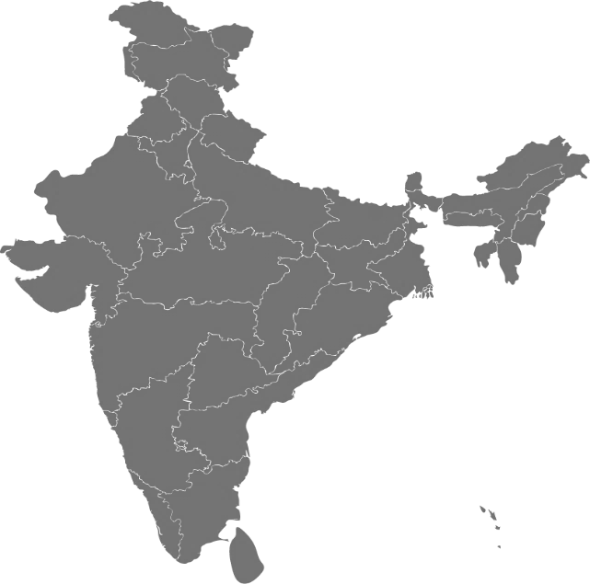
Location Strategy
Location Advantages
Work from Anywhere (WFA) enabled service delivery location
Business Continuity
Pune & Noida are EXL’s Contact Centres of Excellence
Senior management support – easy accessibility due to location advantage
Ready site and infrastructure at Pune and Noida
High literacy rates - access to high quality customer service as well as back office skills
Mature BPO market, high number of resources available in the job market
We have identified Pune and Noida* as the delivery centres for Ekaterra operations. Pune has a rich pool of experienced staff and is a hub for customer service & Noida has a polished analytical and operational capabilities to support natural BCP
Natural BCP (Business Continuity) between Pune and Noida
Work from home enabled workforce
Aligned to ISO 22301 standard
Customised solution with assured recovery, if required
Strong IT connectivity based on IT infrastructure
NOIDA
(Secondary Site)
PUNE
(Primary Site)
Location wise FTE split is determined basis the language skilled staff availability and ensuring 100% support for Ekaterra’s customers
Language Support, customer impacts and associated SLAs
*other locations considered – Romania and Philippines

Slide 7
Proposal (FTE and Coverage)
Our understanding of the volume* distribution of the customer connects across different channels and proposed solution
*Nov Volume data
Covering 91% of the current volume via Omni-Channel Service through the contact Centre on efforts based… remaining 9% volume (coverage-based)
 |  |  | 50 |  | 56 |  | Volume Split
 | MU | Languages | Countries in Scope | Coverage Window | FTEs (Mon-sun) | Language Volume Weightage 100% | Mon-Fri | Sat-Sun
Omnichannel | Americas | English | 7 | 24 hours | 15 | 66.06% | 91% | 9%
Omnichannel | Europe | French | 2 | 9 hours | 3 | 6.09% | 93% | 7%
Omnichannel | NAMET | Arabic | 1 | 11 hours | 4 | 2.53% | 68% | 32%
Omnichannel | Europe | Dutch | 6 | 9 hours | 3 | 2.52% | 83% | 17%
Omnichannel | NAMET | Turkish | 1 | 9 hours | 3 | 2.14% | 91% | 9%
Omnichannel | Australasia | Japanese | 1 | 9 hours | 3 | 1.95% | 94% | 6%
Omnichannel | Americas | Spanish | 7 | 20 Hours | 6 | 1.48% | 88% | 12%
Omnichannel | Europe | French & German | 1 | 9 hours | 3 | 1.39% | 92% | 8%
Omnichannel | Australasia | Mandarin | 1 | 9 hours | 2 | 1.36% | 100% | 0%
Omnichannel | Europe | Swedish | 1 | 9 hours | 3 | 1.27% | 91% | 9%
Omnichannel | Europe | Italian | 1 | 9 hours | 3 | 1.14% | 89% | 11%
Omnichannel | BSPAN | Urdu | 1 | 9 hours | 2 | 1.03% | 82% | 18%
Omnichannel | Europe | Portuguese | 1 | 9 hours | 2 | 0.94% | 91% | 9%
Omnichannel | Europe | Russian | 1 | 9 hours | 2 | 0.83% | 96% | 4%
Omnichannel | BSPAN | Sinhala, Tamil | 1 | 9 hours | 2 | 0.08% | 89% | 11%
Omnichannel Total |  |  | 33 |  | 56 | 90.81% | 89% | 11%
Chat Support | Australasia | Tagalog | 1 | 9 hours | 0 | 5.40% | 63% | 37%
Chat Support | Europe | Dutch, French, German | 1 | 9 hours |  | 0.81% | 80% | 20%
Chat Support | Australasia | Cantonese | 1 | 9 hours |  | 0.48% | 100% | 0%
Chat Support | Europe | Finnish | 1 | 9 hours |  | 0.45% | 82% | 18%
Chat Support | Europe | Norwegian | 1 | 9 hours |  | 0.44% | 82% | 18%
Chat Support | Europe | Polish | 1 | 9 hours |  | 0.41% | 82% | 18%
Chat Support | NAMET | Hebrew | 1 | 9 hours |  | 0.31% | 79% | 21%
Chat Support | Europe | Danish | 1 | 9 hours |  | 0.23% | 86% | 14%
Chat Support | Europe | Greek | 1 | 9 hours |  | 0.15% | 100% | 0%
Chat Support | Australasia | Bahasa, Chinese | 1 | 9 hours |  | 0.14% | 75% | 25%
Chat Support | Australasia | Korean | 1 | 9 hours |  | 0.12% | 100% | 0%
Chat Support | Europe | Hungarian | 1 | 9 hours |  | 0.07% | 80% | 20%
Chat Support | Australasia | Vietnamese | 1 | 9 hours |  | 0.05% | 100% | 0%
Chat Support | Australasia | Thai | 1 | 9 hours |  | 0.04% | 100% | 0%
Chat Support | Europe | Czech | 1 | 9 hours |  | 0.04% | 100% | 0%
Chat Support | BSPAN | Bengali | 1 | 9 hours |  | 0.03% | 66% | 34%
Chat Support | Europe | Ukrainian | 1 | 9 hours |  | 0.02% | 50% | 50%
Chat Support Total |  |  | 17 |  | 0 | 9.19% | 84% | 16%
Estimated call
type volume
contribution
EXL Offers 100% Support for Ekaterra’s Customer Base with 7 Day working window
*Nov 2021 Volume data – the split is subject to change and to be captured real time post transition

Slide 8



Alternate Proposal (FTE and Coverage)
Right mix of Human and Digital workforce - EXL’s proposal for Ekaterra helping manage end to end contacts
CX
24*7 Working Window
Redesign Operating Model
Two Fold approach
100% FTE based model with 24*7 support^
Omni channel – 74.68%
Remaining CHAT - 25.32%
(with Humans backend)
Reduction of headcount and total spend by c48%
Change in Voice Hours of Operations
execution Focus (Chat) model
Omni channel – 59.56% - Voice 18*7 support
Remaining CHAT - 40.44% - 24*7 support
(with Humans backend)
Reduction of headcount and total spend by c52%
Leverage automation to translate native language to English & vice versa.
English speaking agents will be able to support customers from different geographies and languages with this approach, resulting in 50%+ lower cost to serve
Cost
^ Vary from market to market

Slide 9






Future State - How does this look like?
Deploying Conversational AI solution in business processes…
.. to deliver a trifecta impact
ML/AI
DATA
Explore deployment of Conversational AI* basis volume and scale with different languages
Customer Experience
AUTOMATION
Conversational AI
(Powered by Amelia)
Infusing AI into Customer Interactions
Business Outcomes
CLOUD
ANALYTICS
Efficiency
* Exelia.AI, Amazon Lex

Slide 10
2. Transition Strategy
Planned transition strategy to ensure that the move is invisible to customers and stakeholders with seamless transition and improved customer experience and service delivery

Slide 11








Transition Summary
Location Base location - EXL Pune and Noida Work from home(WFH) and work from anywhere (WFA) options available | Team External Staff to be hired based on pre-approved Job Description and Skill-Set as agreed with Ekaterra | Migration High volumes is the key criteria in identifying languages which are in scope Current scope includes 100% volume on Omni channel with chat capability
KT Approach Remote Train the Trainer (TTT) sessions (recorded) to be conducted Documentation to be created during TTT phase | Duration Pre-Process: 1 Week Train-the-Trainer : 4 Weeks Process Training: 2 Weeks Ramp-Up: 4 Weeks | Due Diligence Detailed due diligence to be performed to validate scope, work instructions, assumptions, timelines and project planning
Approach Gradual Ramp, Remote production monitoring and feedback with Onshore SME support | Duration 6 Weeks to pick up ramp volume with Supervised production plan | Digital Command Centre Dedicated Work Force Management resources working in partnership with Client Management team
Robust Governance Model
Robust governance framework to ensure timely and effective communication and alignment
Detailed reporting framework to share progress, challenges and help required
Cohesive partnership and change management approach
Ensuring seamless and immaculate governance during transitions
Location and People
1
Transition and Knowledge Transfer (KT)
2
Supervised Production and Performance Measurement
3

Slide 12

Transition Timeline
Month
Apr’22 |  |  |  | May’22 |  |  |  | Jun'22 |  |  |  |  | Jul'22 |  |  |  | Aug'22 |  |  |  |  | Sep'22 |  |  |  | Oct'22 |  |  |  | Nov'22 |  |  |  |  | Dec'22
4 | 11 | 18 | 25 | 2 | 9 | 16 | 23 | 30 | 6 | 13 | 20 | 27 | 4 | 11 | 18 | 25 | 1 | 8 | 15 | 22 | 29 | 5 | 12 | 19 | 26 | 3 | 10 | 17 | 24 | 31 | 7 | 14 | 21 | 28 | 5 | 12 | 19 | 26
Week
Programme Level Activities
Business Approval
Ramp
4 weeks
Statement of Work Finalization
Business Award
Seeding / Hiring
Steady State
3 weeks
Due Diligence
Pre- Process
3 weeks
Due Diligence for CRM Solution
Process
3 weeks
Transformation Due Diligence(Chat Bot capability)
OJP
8 weeks
EXL IT, Infra and WFH Enablement Setup
Training Documentation
8 weeks
Hiring & Seeding
Transition Timelines
TTT- Process Training & Certification
Process Training & Go Live-56 FTE
Phase 1-Omnichannel
Phase 2-Chat only
12 Wks.
1 Wk
2 Wks.
1 Wk
1Wk
1 Wk
2 Wks.
2 Wks.
4 Wks.
Key Assumptions:
EXL proposes a Train the Trainer followed by a Train the Team model to reduce dependencies
All in-scope work to be processed from EXL Pune location, with BCP Noida and hybrid model of work(WFH, WFA)
Ekaterra Trainer availability for the duration of TTT has been assumed for all the functions
Training content/SOP’s to be reviewed and approved by Ekaterra team prior to initiation of knowledge transfer
Ekaterra Leads /SMEs to conduct Quality Audits during Ramp period and providing calibration support for EXL audit team
All timelines to be validated during process of Due diligence and changes will impact the Implementation plan
For Phase 2 languages, chat bot capability will be available in supporting translation(Specific local languages)
EXL to use existing CRM model of Ekaterra for training till the time new CRM solution has been built

Slide 13
3. CRM
design and develop a CRM (Customer Management platform) and support on integrations

Slide 14



CRM
EXL would partner with Ekaterra in CRM deployment journey. There are two options for deployment, which EXL will evaluate through a 3 week due diligence exercise.
Option I- Develop a CRM platform for Ekaterra Carelines
Option II- Leverage Market leading CRM platform and support E2E from CRM selection to deployment and stabilization
CRM PLATFORM
Option II: EXL would create a working partnership with Partner basis Ekaterra CRM requirement
Established CRMs with history
NICE,
Salesforce,
Genesys,
Zendesk
New Age CRMs (Startup ecosystem)
Freshworks
ZOHO
Option I: EXL will work with Ekaterra closely to design and develop a CRM (Customer Management platform) and support on integrations to Ekaterra CDP and CMI systems
No/ Low code design
EXL Digital Suite
CX led solutions
Conversational AI
AI/ML/ NLP Solutions

Slide 15

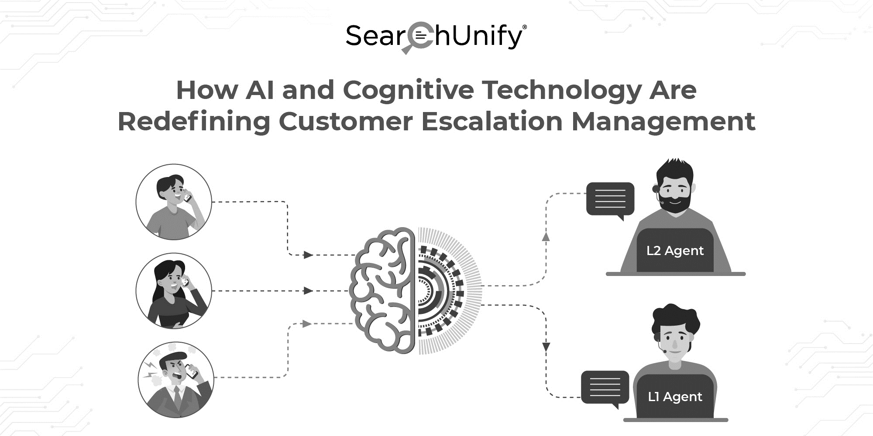

Option I - Build CRM for Ekaterra Below schematic is a high level modular design for proposed CRM design basis initial understanding of Ekaterra Careline requirement
1
Intelligent Application
User Experience
Speed of execution
Reporting & Visualization
2
Complaints / Escalations
CRM Intelligence
Customer Support with CRM
User experience driven Product design
Conversational AI
Calls/front office
Case Input
Complaints
Social media
messages
Queries
Reimbursement requests
Case review & resolution
Refer any previous communication
Update Status
Check status
Response to Customer
Record resolution
Status
Customer
feedback
Email
Careline
Agents
3
Chat
Case Input
Complaints
Social media
messages
Queries
Reimbursement requests
Case review
Refer any previous communication
Update Status
Check status
Respond back to Customer
Integrate seamlessly using Cloud & APIs
Intake
Social Media
Exceptions
4
Cognitive lead Intake
of Customer
input
API integrations
40 to 60% faster deployment using EXL pre built digital components
SMS / Text
Mobile App / Web
Reimbursement
Application
Inventory Data
Application
Any application used by Carelines
EXL will perform 3 weeks of Discovery phase along with Client Business & IT teams.
Cost of Discovery phase: $ 20K. To be discounted if Ekaterra go full scale implementation

Slide 16
4. Transformation
Digital Intelligence bringing Data, Domain & Digital together with focus on changing customer expectations

Slide 17
Key tenets of our transformation solution
Establish dedicated transformation CoE for Hyperautomation and Analytics
Invest in innovative commercial construct and contractually underwrite savings
Ready to deploy pre-built Hyperautomation, AI and Insights solutions and accelerators
Best in class analytics CoE to deliver sustainable competitive advantage
Solution engineering at Speed leveraging our knowledge of CX environment, processes and assumed pipeline of transformation opportunities
Building blocks for the right target operating model

Slide 18



Omni Channel Support
Key Challenges in Ekaterra Customer Line Operations
Thick human contact Centre Operations
Broken customer journeys
Low Digital Penetration
Legacy systems
Lack of Multilingual support capability
EXL’s Solution - how are we transforming
Reduce inbound customer contacts
Deflect contacts to digital channels
Leverage data to improve CX
Contacts origination
Contacts handling
Contact analytics
Exception reduction in customer journey
Palette for contact Centre transformation
Domain led embedded analytics
Identifying contact drivers across the customer journey and proactively reduce them
Customer journey mapping
Reduction in process fallouts
EXL Management Information Assistant
Deflect contacts from humans to digital channels
Webchat & Email Translation solution
EXL Email Solution
EXL EXELIA.AITM - voice and chat automation
Contact Centre analytics across all channels to
Improve customer journeys
Improve regulatory compliance
Improve customer retention
CRM
> 30 - 35%
10 - 15%
~5 - 10%
Productivity improvement
Elimination of inbound voice contacts
Improvement in NPS

Slide 19
DEMO - Webchat & Email Translation solution

Slide 20
Omni Channel Support
Key Challenges in Ekaterra Customer Line Operations
Thick human contact Centre Operations
Broken customer journeys
Low Digital Penetration
Legacy systems
Lack of Multilingual support capability
EXL’s Solution - how are we transforming
Reduce inbound customer contacts
Deflect contacts to digital channels
Leverage data to improve CX
Contacts origination
Contacts handling
Contact analytics
Exception reduction in customer journey
Palette for contact Centre transformation
Domain led embedded analytics
Identifying contact drivers across the customer journey and proactively reduce them
Customer journey mapping
Reduction in process fallouts
EXL Management Information Assistant
Deflect contacts from humans to digital channels
Webchat & Email Translation solution
EXL Email Solution
EXL EXELIA.AITM - voice and chat automation
Contact Centre analytics across all channels to
Improve customer journeys
Improve regulatory compliance
Improve customer retention
CRM
> 30 - 35%
10 - 15%
~5 - 10%
Productivity improvement
Elimination of inbound voice contacts
Improvement in NPS

Slide 21
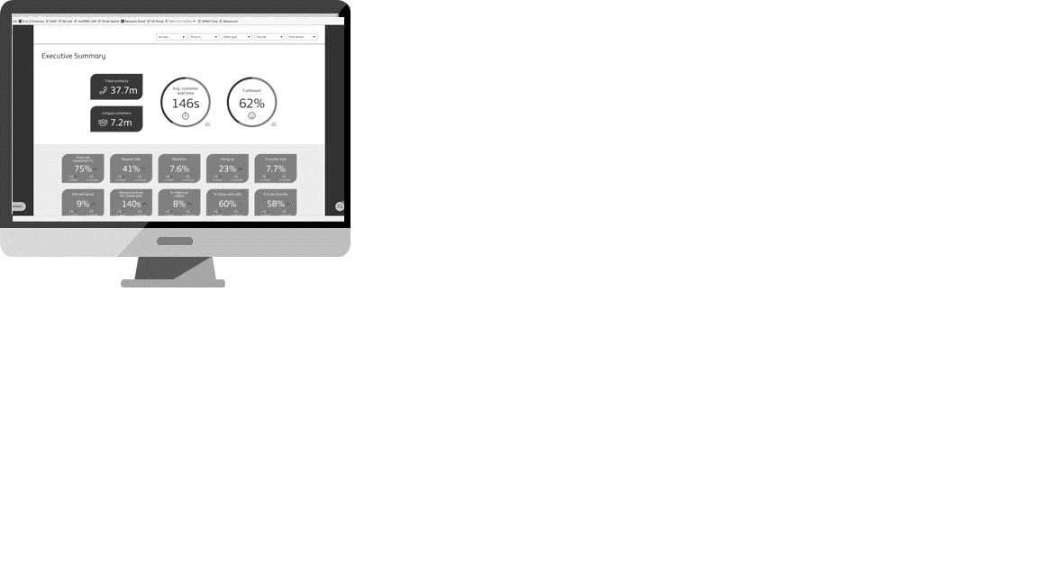






Embedding Analytics to drive Ekaterra Intelligence
Customer data
Agile Delivery
Contact data
Sprint Planning
E2E Customer Journey Review
Operational Efficiency
Identify fallouts through data overlay & RCA
Exceptions data
Domain Experts
Identify the right lever for improvement
Events data
Integrated data signals
MIA
Train
Tune
Test
NPS
Customer Lifetime Value Model
Sales data
NPS Simulators
Front office
Back office
Cost to Serve
Churn
Compliance Assistance
Survey data
Analytics Models & Tools
Ex
Cx
Forecasting
Text Analytics
Deep Learning
EXL Exelia.AI
Data scientists
Employee data
Growth
Compliance
Cost to Serve
Connected Data - Data CoE
Connected Insights
Connected Operations & Outcomes

Slide 22
5. IT Solution
robust, scalable & flexible Technology stack for the solution that is aligned to Ekaterra requirements

Slide 23
Key Technology solution assumptions
SOLUTION COMPONENT | DESIGN CONSIDERATION
Network and Telecom | EXL will leverage Public Internet based telecom with 100 kbps per user bandwidth provisioned to access the CRM platform
Contact Center Platform | EXL’s Cloud Contact Center platform will be leveraged for customized call queuing and treatment to inbound voice calls EXL’s proposed CRM platform will be leveraged to service email, chat, social, webforms and rating & review interactions for Ekaterra EXL will provision in-country DDI / ITF numbers to collect inbound calls from Ekaterra For each of the in-scope countries where EXL will provision the DDI / ITF number, Ekaterra will need to comply with the local telco regulatory requirements and provision the required documentation to the local authorities before commencement of voice services All inbound calls will be recorded (audio only, no screen) on EXL’s Cloud Contact center Infrastructure Call recordings will be retained online for a period of 7 years within EXL’s Cloud Contact Center platform EXL’s has not factored in Speech Analytics solution EXL has not factored in long-term call archival solution and the transfer of call recordings to Ekaterra in the solution EXL has not factored any outbound calling functionality for the agents or calls requiring transfer back to Ekaterra EXL has factored in 40 kbps per seat voice bandwidth with G.729 codec to route the calls to the agents
IVR and Integration | EXL has factored standard IVR solution with static announcements The IVR will be provisioned with up to three levels of menu options and touch-tone (DTMF) based menu routing EXL has not factored ASR (Auto Speech Recognition) or AL/ML based advanced conversational IVR solution EXL has not factored any CTI integration (including screen popup) /Web integration/ self-service functionality through IVR

Slide 24





Proposed Technology solution design
EXL proposes to leverage its robust, scalable & flexible Technology stack for the solution that is aligned to Ekaterra requirements
EXL’s Contact Centre platform with skill-based routing , real-time and historical analytics and unified customer experience
Resilient Cloud hosted Contact Centre platform designed on inherent principles of high-availability and reliability across different redundant zones
Solution Schematic
Solution Highlights
Network and Telecom
EXL’s Enterprise Shared Technology infrastructure with logically segregated network
NextGen Secure VPN solution for Work From Home (WFH) users to connect with EXL DataCentre
EXL’s proposed CRM platform securely accessed by EXL Associates through Internet
CRM Platform
Ekaterra Global Customers
Cloud Contact Centre
Voice and Contact Centre
EXL Cloud Contact Centre and call recording solution integrated with CRM platform
EXL provisioned in-country DDI / ITF numbers for call collection from Ekaterra markets
100 % call recording with 7 year online retention and integrated Quality Management system
Cloud Contact Centre integrated with CRM platform for unified customer view and CX
Internet
EXL Delivery Site
Home Internet
IPSec VPN
Systems and Business Applications
EXL Work from Home Associate
EXL’s Enterprise shared Windows AD with strong group policies and restricted user profile
Hardened & encrypted endpoints enabled with Next-Gen EDR, DLP and CASB tools
ITIL aligned processes and practices , 24x7 Servicedesk and state-of-the art monitoring tools
Enterprise Shared Services Domain, DHCP, DLP, Antivirus
EXL Associate
The above network schematic is a broad view of the proposed solution and does not depict the exact placement of the equipment

Slide 25
6. Commercial Construct
Transparent, Flexible and Progressive

Slide 26
Commercial Construct
Components | Proposed Delivery Location | # FTE | FTE Rate (Euro) / Annum
FTE Rate per Month CX Operations | Pune and Noida | 56 FTEs | € 36,261
EXL solution is on the assumption of 1800 productive hours per annum. Please note that resources are allowed to avail time for meals and two small breaks during office hours which have been excluded while computing the staffed hours per annum
EXL pricing includes employee’s standard background verification, any additional verification such as specific drug test will be charged at actuals
EXL has proposed Pune as the service delivery location
Deal Term is for 5 years. COLA will be applicable from year 2 onwards which is linked to Consumer Price Index (http://labourbureaunew.gov.in), capped at a maximum of 4% per annum
EXL Quoted rates exclude costs of any BCP component. BCP, if required, will be quoted separately
EXL Prices are exclusive of tax, levy, or similar governmental charge that may be assessed by any jurisdiction, including without limitation, any export, or local VAT, lease tax, sales, use of goods and service tax and excise duty
EXL Pricing does not include any cost for third party audits, if required the same will be charged on actual basis
Cost of personnel is based on EXL's current understanding of the level of complexity for the processes. Any changes in the complexity of the processes leading to different personnel costs or variation in degree of supervision assumed would require EXL to adjust its price
EXL Pricing includes recruitment cost; the same would be borne by EXL; also, cost of recruitment of backfill attrition would be borne by EXL Migration costs will be billable as pass through EXL will leverage its Cloud Contact Centre platform for customized call queuing and treatment to inbound voice calls. EXL has assumed 40 kbps per seat (G.729 codec) to access this environment for voice (phone) interactions. EXL will provision in-country DDI / ITF numbers (one number per country) to collect inbound calls from Ekaterra as per the matrix included in the Pricing Template document provided separately and corresponding per minute charges have been factored into the pricing. EXL has provided the blended cost per agent per annum. However, some of the languages are niche in nature (e.g.: the rate of a Dutch speaking resource is 2X than that of an English speaking resource), The cost might vary incase the current mix of volume (by languages) change. Thus we have provided detailed list of languages along with FTEs and rates in the Pricing Template document provided separately

Slide 27

EXL Digital Solutions

Slide 28


Our AI-led management information assistant (MIA) for reporting & insights
Real time view of operations health, SLAs and regulatory outcomes
Generate rapid improvement opportunities using customer journey fallouts
Single source of truth for decision making
Customer Journey diagnostics
for RCA and agile sprints for rapid iteration and experimentation
Operations management
Transformation
Collective focus on priorities and customer outcomes
Continuous learning and
collaboration as a way of life
Phase 1
(Day 1 Onwards)
Phase 2
(Day 180 Onwards)
Management Information Assistant
‘What happened’, ‘why it happened’ and ‘what needs to be done’

Slide 29

Exelia.AI achieves superior customer value
Deep contextual understanding
Customer care depends on human levels of comprehension not simple task bucket classification. Exelia’s is the only AI system capable of such levels of human understanding.
Flexibility
Your Customers should be able to change topics at any time just as they would with a human agent. Exelia follows when you switch from one state to another and returns to your original goal.
MetaDB
FAQ
Episodic
CQA
Continual learning
Learning is key to your customers experiencing continually improving service. Just like a human, Exelia learns from the variations in issues she was not yet trained to address.
Multi-threaded
Exelia’s brain is modeled after the human brain. All the Centres of her brain respond in tandem to make for a rich customer experience.
BPN
Logical
Triples
AIML
Semantic Parsing
Affective connection
Exelia has an empathetic connection with the customer, yielding much better satisfaction scores. She employs a 3-dimensional post sentiment analysis to ensure affective alignment with the customer.
Unsupervised analytics
Exelia automatically assesses her live interactions to determine customer satisfaction at every step of their journey. She can then advise the business user on retention, at-risk and loss-prevention.
EQ-FR
Semantic
Executor
Human social talk
Exelia learns from other conversations to develop improved social talking capabilities. She mines embedded intelligence to achieve human levels of fluency.
Ease of adoption
+50 Integrations pre-built for quick use. Organizations can also create their own re-usable library of integrations for internal systems.
Time to value: Exelia builds Exelia
Exelia’s Digital Employee Builder provides a guided path to implementation. The new intuitive Process Designer streamlines the entire development workflow.

Slide 30
What we are achieving for the process
Embedding AI & Automation in Email Operations
Client Admin./ ERP systems
Automated Response
Emails sorted based on skill and urgency
90%
Customer
Email box
ML Algorithm Based prioritizing and Sorting Tool
ML Algorithm
Based Intent Identification
Machine Learning Input
English Emails – EXL Location
Smart Responses aiding faster response time
Quality Check
(To reduce over time)
I MAIL
Bifurcation of emails
Classification of queries per priority: Binary & Multiclass
No Response Emails
10%
ML-enabled work prioritization
ML-enabled updates to match set rules
Non- English Emails - EXL Location
Emails with customer queries
Orders. Basic Enquiries
Smart Responses aiding faster response time
Straight through processing
Customer satisfaction
Improved TAT
Improved agent productivity
Improved returns & refund experience

Slide 31

Webchat & Email Translation Assistant solution
Context
Proposed Target Operating Model
Webchat Translation Assistant Solution
Leverage automation to translate native language to English & vice versa.
English speaking agents will be able to support customers from different geographies and languages with this approach, resulting in 50%+ lower cost to serve
15+ Languages
< 10,000 Annual volumes
40 FTEs required in As Is Operating model
Unsustainable Operating model
Message in native language
Convert in English
Respond in English
Convert to native language
Message sent to Customer
Customer
Customer
Chat BOT
Agent
Chat BOT

Slide 32
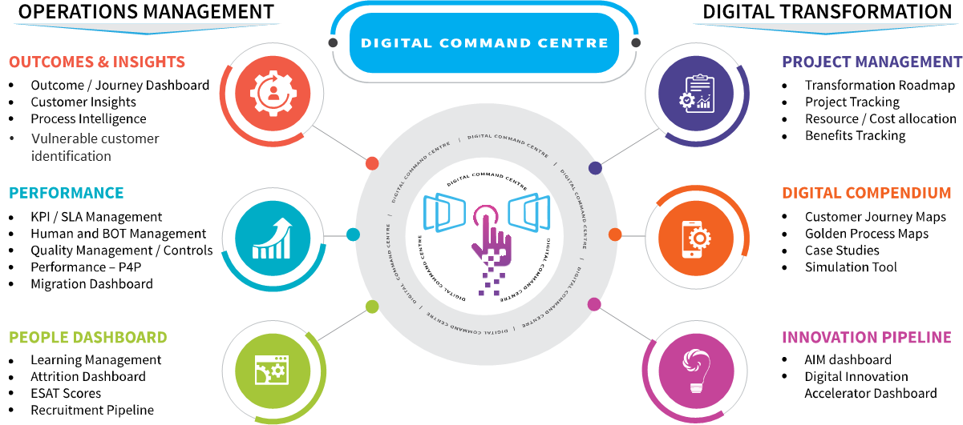
Customer Operations- Digital Command Centre
EXL Digital Command Centre (EXL NerveHubTM) allows us to embed Digital Intelligence in Operations and deliver improved outcomes
EXL digital command centre (EXL NervehubTM) solution
A comprehensive enterprise solution that helps manage all aspects of operations
Robust industry-agnostic platform
Links operational metrics with outcomes
Manages digital workforce, and drive customer outcomes through embedded intelligence and real time insights
Unifies data from multiple sources
Provides powerful representation across KPIs (workforce, quality, process, customer journeys etc.)
Digital command centre
10-15%
Reduction in Failure demand (repeat cases, complaints)
8-10%
Improvement in Employee Productivity
3-5%
Improvement in NPS
20-30%
Reduction in cost of operations
10-12%
Improvement in Service Levels

Slide 33
Why EXL ?
Strategically investing in digital solutions that enhance customer experience
Bringing industry best practices from other Contact Centre Operations and engagements
Increased flexibility with transaction- and outcome-based pricing models
Skin in the game partnering to standup green field operations for Ekaterra
Transparent and flexible commercial construct
Industry leading Domain-expertise best in class -management and delivery teams

Slide 34
Aditya Chaturvedi
exlservice.com
Vice President, Account Management
Global headquarters
Aditya.Chaturvedi@exlservice.com
O: +1(408) 524-9200 M: +1(201) 993-7501
320 Park Ave, 29th floor New York, NY 10022
T: +1(212) 277-7100 F: +1(212) 277-7111
United States | United Kingdom | Australia Bulgaria | Colombia | Czech Republic India | Philippines | Romania | South Africa
© 2022 ExlService Holdings, Inc. All rights reserved. For more information go to www.exlservice.com/legal-disclaimer

Slide 35
Annexure

Slide 36




Our operating model for Ekaterra
Executive sponsorship
Program “Ekaterra” will have executive sponsorship from our Senior Executive office
Senior Operating Leadership and dedicated Client management
Tiered Governance structure for seamless communication
Right talent – right location
External validation on choice of location
Availability of right skill set
Established partner model to hire - scale at shorter intervals
Dedicated Technology team
Strong operating practices
Leverage our SMART methodology for process transition – dedicated program office
Leverage our CX academy for pre process / process and refresher trainings
Relevant Market experience to be hired for Ekaterra programs
Digital and Data enabled operations
Dedicated Transformation office for program roadmap and planned interventions
Timely review and version updates on various transformation levers – map to the “best in class”

Slide 37






Our commitment to Ekaterra…
EXL will provide digital first and scalable customer support services that delivers “best in class” customer experience
Operation Excellence
Innovation culture
Financial savings
Exceeding service levels across the network and setting best in class benchmarks
Driven through All Idea Matter (AIM) process for rewarding staff for generating improvement ideas
In Operating spend across the enterprise through Hyperautomation and digital transformation
Business Resilience and Scalability
Digital Operations & Continuous Improvement MIA
Improved outcomes with EXL CONNECx
Invest in infrastructure dedicated CRM to Ekaterra along with flexible work models to deliver best in class CX
To connected front and back office orchestrated to deliver right customer/ business outcomes increase in efficiency
AI-assistance for accuracy and speed in customer service
Employee Engagement
Richer data Analysis and Insights
Platinum Status
Best in class employee benefits and investing in learning continuum and R&R
Capturing information at a granular and actionable level
Access to EXL senior leadership and dedicated client partner

Slide 38

How are we aligned to the culture? Its based on the shared values between Ekaterra and EXL
Talent Acquisition
Wellness, Development and Retention
Talent-first mindset
Culture fitment
Talent inventory succession
Physical & mental wellness campaigns; work life balance
Real life experience during Pre-hire orientation
Competitive compensation packages & differentiated rewards
45% referrals in hiring
Onboarding
Diversity and Inclusion
Culture, Value, Regulatory training and certifications during onboarding to drive right behaviour from Day 1
Company-wide initiatives aimed at promoting diversity and inclusion
(Super Mom, WE, Managing Unconscious Bias, etc.)
Culture
100% Digital On-Boarding
38% Gender Diversity
at a company level
67% diversity on our operating committee
Open and Transparent Communication
Corporate Social Responsibility
Approachable Leadership
High impact touch points
Om Foundation and Deep Griha School supported by clients and EXL
Regular Pulse Checks
Processes to drive right behaviour
Impact Sourcing
26000+ contributed time and money to charitable and community initiatives in 2021
95% Employee Satisfaction Score
19% Staff turnover rate
#Equal Opportunity & Diversity #Corporate Social Responsibility #Digital HR & Engagement

Slide 39
BGC (Background Check)
Band A (Agents) in operations management
Criminal Background Check – 100% (Present and Permanent Address)
Education Check – 100% (including without limitation highest qualification)
Employment Check – 100% for the period of last 1 (one) year
Band B (Team Leader/Supervisor) & above in operations managements and all bands in others
Criminal Background Check – 100% (Present and Permanent Address)
Education Check – 100% (including without limitation highest qualification)
Employment Check – 100% for the period of last 1 (one) year
Global Database Check – 100%

Slide 40




Transition Dependencies and Risks
Risks
Mitigation
Hiring
Screening of right skill set resource with no or minimal FaceTime
Sourcing for different languages could be challenging at one location
Defined job descriptions and video interviews to be conducted
Work from anywhere model to ensure right candidates are sourced and hired
Unavailability of detailed and extensive documentation
Availability of required Ekaterra Trainers/SMEs
Same level of process understanding within the batch and effectiveness of training
Robust documentation review and sign off timelines
Alignment of Ekaterra trainers during TTT phase
Day end knowledge recap sessions to ensure consistency
Weekly assessments and corrective actions, more time for hands on practice
Knowledge Management
Additional support and refresher sessions to be provided wherever applicable
Weekly performance review touch points
EXL to setup / develop quality mechanism
Ramp Performance Management
Handling multiple queries during Ramp
Bandwidth of Ekaterra SME to do Quality checks during Ramp
IT Accesses
Delay in obtaining system access may delay the Knowledge Transfer
Delay in provisioning of voice services for in scope countries
Ekaterra to provide system access resources within 1 week of Pre – Process training
Ekaterra will have to work with service provider to ensure call routing from their service provider to EXL within timelines

Slide 41
Talent acquisition capability and Process flow
EXL has a fair and transparent recruitment strategy to attract and hire the right talent, that can be customised as per Ekaterra’s needs.
Our industry leading hiring policies and practices focus on “hiring for retention” and “hiring for quality”.
100+
In-house recruiters in India
10000+
Annual hiring capacity
200+ Onboarding capacity per day
100%
Digital onboarding
Centre for Talent
State of art recruitment & training Centre
55+
Tie-ups with specialized recruitment agencies
Talent acquisition process flow
Gathering market intelligence on pool availability & mapping the skills & candidates.
Sourcing through -
External channels:
Social media
Job boards
Campuses for Hiring CAs
Domain specialized vendors
Referrals program
Internal channel:
Existing employees
Assessment on
Communication
Experience
Stability
Past experience
Strengths
Opportunity Areas
Reason for Change
Team Management
Skills fitment as per JD
JD Creation by Operations SME and HR
Details Captured are
Soft skills
Technical skills
Qualification
Years of experience
Technical Round Manager and above for
Domain knowledge, Behavioral & Cultural fitment
Resume screening
Adaptive automated assessment
Validation of Candidate's documents
Salary negotiation
Offer Roll Out
Gamified digital EXL On-boarding
Job description
Market intelligence & sourcing
Pre screening
HR assessment
Domain & operational assessment
Background check &
offer rollout
On-boarding & orientation

Slide 42

HR Model designed to enable an exceptional CX based on the shared values between Ekaterra and EXL
‘HR model’ for Ekaterra
‘Your process our people’
‘Your process your people’
Develop Ekaterra HR strategy
for client operations
The shift
Check for consistency
in practices
Measure success
Outcomes
1
Strong Ekaterra brand presence
Tea Corners, Samples
High performance in line with business goal
Engagement and Knowledge Retention
3
Intake
Build
& review
HR
blueprint
Implement
Measure
Govern
Customer sentiment analytics
Ekaterra HR practices
4
Employee sentiment analytics
2
Ekaterra based touch points in critical areas
Rigorous
joint reviews
Arrive at a combined HR Value Proposition
Key to Ekaterra Based HR
Strong Partnership Model
Ekaterra Branding & Culture
Strong Governance
Co-creation and joint management of critical HR touch points
Embed your culture and brand to create strong franchise
Proactive joint reviewing to avert, identify and resolve critical talent situations

Slide 43
Training Framework
EXL has a robust training framework which caters to all the phases of the employee life cycle:
Foundation Training
Operations Training Group
Ongoing Development
Pre-Process Training Customised
Process Training
Foundation
OJP* & Ramp
Product & System Training
Regulatory and Compliance Training
Quality Parameters session
Complaint handling session
Language Enhancement intervention for voice and emails to set the correct tone of voice
Culture Training
Language Training- CEF (Common European Framework)
Customer Service Excellence
Email Etiquettes and Business writing
Industry Training- Prelude to process training and sets the right tone for the product/services catered like Lipton, Pukka and Tazo etc
Ekaterra overview- Helps in imbibing the client culture
Support from SMEs , trainers and TMs- Timely huddles/ Sessions
Weekly/Monthly Performance reviews
Feedback & Coaching
Performance management
Bottom quartile management
Based on individual needs identified during appraisal/ talent review
Cross training
1 week*
2 weeks*
4 weeks
Process Specific Capability Development
Specialised training through domain academy
Process Excellence (Lean and sigma)
Advanced call handling on specific processes
RPA and digital intelligence sessions
Behavioural and Leadership sessions by Capability Development
*OJP - On the Job Processing

Slide 44
Knowledge Management
EXL will follow a collaborative and iterative approach with the 3-pillar framework for the knowledge base management comprising of content creation, maintenance and governance
EXL will collaborate with Ekaterra to create the product content as per the business need using the ADDIE* model of instructional design Review, iteration and Final sign off Creation of supplementary material for agent training (need basis) Training material review and sign off The content created will follow an agreed documentation control framework – naming convention, version control etc. Knowledgebase/Intranet hosting | EXL has a robust change management procedure where all changes are assessed, approved, implemented and reviewed in a controlled manner 2-way communication - Process or product updates/changes will be received from Ekaterra Knowledge articles usage, queries/feedback from customers will be feedback by EXL to Ekaterra Annual review of content and sign off from Ekaterra | Regular governance calls with Ekaterra for change implementation and communication All documents will be version controlled Changes will be clearly identified and mentioned in the version control and incorporated in the document Updated content can only be hosted on the knowledge base post sign off from Ekaterra All the content is available and accessible to all concerned at all times
Content Creation
Content Maintenance
Content Governance
*ADDIE model - Analysis, Design, Development, Implementation, and Evaluation

Slide 45




Knowledge Transfer Approach
EXL proposes ‘Train the Trainer’ knowledge transfer model to ensure an effective transition, reduce onshore dependency based on process specifics and complexity and least business disruption
Train the trainer
Ekaterra trainers/ SMEs
EXL trainers/ SMEs
EXL production staff
Develop resource
certification strategy in consultation with Ekaterra
trainers/SMEs
Multiple knowledge
assessments and
one final
assessment
Minimum two tasks across channels (Actual/mock transaction) as part of final certification
Hands on practice across channels during knowledge transfer and OJP under trainer’s supervision
Establish “pass” criteria for each mode of assessment in consultation with Ekaterra
Support required from Ekaterra :
Availabity of Ekaterra trainers/SMEs to support training and OJP for EXL TTT resources
Provide detailed process understanding and walk through during TTT including query management, feedback sessions and Q&A
Create and evaluate assessments to certify EXL staff by the end of training to ascertain their readiness to initiate ramp-up/provide subsequent training to EXL batches
Provide Quality support during initial stage of OJP/Ramp
SME - Subject Matter Experts

Slide 46
7. Workforce Management
Work Force Management (WFM) approach helping staff optimisation and creates flexibility in Operations

Slide 47
End to End Workforce Management
EXL’s Work Force Management (WFM) approach aligns with our industry-leading data and analytics capability (focused on accurately forecasting and scheduling workforce requirements). Coupled with intelligent platforms, sophisticated modelling techniques
Special Events
Historical Trends
Scheduling Input
Schedule Optimization
Excel
MS Access
SQL
Power BI
iDashboard
Genesys
Verint 360
Aspect eWFM
Nice TotalView
Avaya
Cisco
Erlang
Intraday Patterns
Available Staff, OT Hours
AHT, Shrinkage, Attrition
Scheduling Preferences
Sync HC with HR/OPS
Verint/Excel & Erlang
Upgrade Forecast, OPA
IDP* Review
Outages
Churn or Growth
Forecast Considerations
Marketing Promos
Seasonal, Cyclic
Intraday Game Plan
Published Schedules
Review Deficient Intervals
Solicit OT/VTO*
Delivery against forecast
Monitor, Shrinkage, AHT, Absenteeism
Consecutive Off
Schedule Preferences
Time Adjustment Access
Payroll Visibility 3
Event Calendar
Weather
Forecasting
Scheduling
Performance reporting
Capacity planning
Intraday management
Key Inputs
Staffing Model
Intraday Game Plan
Monitoring & Reporting
Client Specifications
Forecasted Volumes
Service Level Goals
AHT Target/Glides
Operational Inputs
Required FTE & HC
Call Capacity
Hiring Needs
Seat Capacity
AHT Glide Path
Review Deficient Intervals
Solicit OT/VTO
Delivery against forecast
Monitor Shrink, AHT, ABS
Service Level Management
Cross Staffing, Re-gate Staff
Schedule Compliance
Consolidate Call Drivers
Interval Reporting
End of Day Summary/Analysis
Service Delivery
Operational Inputs
Cross-Functional Coordination
Ramp to Steady State
KPI Achievement
Perform to Glide Path
Build Agent Tenure
Intraday AHT
Historical Shrinkage
Attrition Trends
Schedule Compliance
Skype IM with Ops and support
Join Client Bridge as needed
Escalation Triggers
Ticketing & Incident Response
BCP Execution
*OT/VTO - Overtime/ Voluntary Time Off
*IDP - Intra Day Performance
*OPA - Off Phone Activity ( Training/Quality etc.)

Slide 48
Supporting Crisis Situations
EXL can readily increase staffing by 20%+ for any unplanned or planned call outs - through scheduled overtime, shrinkage management and incentives.
EXL will also deploy “additional heads” from similar non-competing business along with 100% chat support available 24*7
Revised Capacity Planning based on the input received from clients
A
Illustrative view on Long term forecasting
Re-run the forecasting model to agree on the firm forecast for Oct
Long Term Forecasting (Seasonal peaks)
Long range forecasting (3 months)
Enabling view of hiring and training requirements
Internal cross skilling programs
Peak management through long term forecasting
Resources onboarded
150 FTE
Current Month
100 FTE
100 FTE
100 FTE
Apr
May
Jun
Jul
Initiate new hiring req. for 70 FTE
Training Initiate for new hires
Cross training plan agreed with the business
Training completed and ramp initiated
B
Traction through rigor on Real Time Monitoring and frequent updates to Business on the performance
Short Term Planning (Intraday)
Half hourly call data analytics to enable right schedules
Real Time Queue monitoring to manage peak volumes
Schedule optimization (attendance, break and break management)
Over Time
Cross utilization of staffs
Illustrative view on short term forecasting
Repeating same activity on Wk-9 for future weeks, this is an ongoing process
Schedule Optimization
Leave Management
Sharing the updated plan with Business
Wk-1
Wk-2
Wk-3
Wk-4
Wk-5
Wk-6
Wk-7
Wk-8
Wk-9
Wk-10
Record of recent arrival trend
Analyze the recent peak & turfs
Cross trained staff identification
Deployment of Cross trained staff
Traction through rigor on Real Time Monitoring and frequent updates to Business on the performance

Slide 49


Digital First Contact Centre - Connected Customer Experience
Disconnected present….
….Connected future
Disconnected Outcomes
Data Silos
Connected Benefits
Connected Data
Broken Customer Journeys
Insufficient Customer Feedback Loop
Connected Operations
Connected Insights
Running Efforts in Siloes
Misaligned EX & CX
Connected Strategy
Connected EX & CX
-7
NPS
4-6%
Cross-sell
50-60%
Higher cost to serve
+30
NPS
10-15%
Cross-sell
25-30%
Failure demand

Slide 50

Leveraging our EXL CONNECx platform to deliver AI-infused customer experience
Target Operating Model design (Consolidation, Simplification, Right-shoring, Queue design, etc.),
CONNECTED STRATEGY
(Enabled by EXL Blueprint)
Best Next Action
CONNECTED CX & EX
(Enabled by
EXL DIVA)
Speech Analytics
CX Benchmarking & Best Practices
EXL CONNECx
NLP based interactive feedback capture
CX Journey Design – Moments of Truth
AI-Coach for behavioural nudges
CONNECTED OPERATIONS (Enabled by
EXL MIA)
CONNECTED
DATA & INSIGHTS
(Enabled by EXL Analytics)
Data Strategy
MDM
WFM Command Centre
CONNECTED INTERACTIONS
(Enabled by
Exelia.AI)
Data Quality - IRIIS
Contact avoidance - Proactive management of issues
50+
Data points reviewed across the Customer Journey
Cross-sell
Data Enrichment
Actionable Insights
Front and Backoffice integration
Omni-channel platform (Genesys)
Real time view of customer journey
Conversational AI (IPSoft)
Automated IVR / IVR optimisation
Proactive customer contact
Digital containment (self-service, chat, etc.)

Slide 51


How will we deliver transformation
Calls/ front office
Email
Chat
Social Media
Exceptions
SMS/ Text
Mobile App/ Web
Holistic review of all Digital channels
RFP Stage
Go - Live
YoY
25% - 40%
Digital
Solutions
EXL provides an overview of all applicable solutions in Client Operations
Transformation Roadmap is created for scope, process/ tech changes, feasibility etc. This activity is conducted 3 - 6 months post transition
Post validation the Year-on-Year transformation roadmap agreed between Ekaterra & EXL along with Costing (over & above contractual)
At beginning of each Year, Transformation plan is tweaked & firmed up as required (in collaboration with Ekaterra)
Indicative Productivity
by Lever
5% - 8%
Continuous
Improvement
For specific requirements like CRM, we will provide an implementation roadmap along with a proposal for Due Diligence
Robust Transformation program governance is followed for on time execution & benefit realization
All Digital solutions will be evaluated basis Volume scale and viable Cost benefit analysis before implementation

Slide 52





Scope of analytics intervention for Ekaterra
Facets of Analytical solutions basis our understanding of your requirement
1
Customer experience
Data quality management
5
E2E Customer & Employee Journey Mapping
ESAT, CSAT, NPS tracking (Survey Management)
NPS simulator, CLV
Key Data Element tracking
Data Validation, Verification, Completion
Master Data Management
Customer Golden Records
Analytics
4
Voice
Reporting & MI Systems
2
IVR, Auto response
Customer Self serve
Automated Voice response: EXL EXELIA.AI®
Silo to Synergy
Real time Dashboards
EXL MIA enabled Command Centre
Forecasting
3
Call Volume Forecasting
Demand Forecasting
EXL Propensity & Forecasting Models
©2022 ExlService Holdings, Inc. All rights reserved.

Slide 53

Key Tenets of Technology Solution
Agile and Rapid Business Technology enablement leveraging EXL’s Contemporary Technology stack
Established Governance, methodology and proactive risk management strategy for seamless transition
1
2
3
Transitioning Methodology
Robust Technology Stack
Operations Management
Risk-Mitigated Transition with delivery talent / specialists bringing best practices and innovation
Executive Leadership sponsorship with established governance
Collaborative Design and planning workshop with Ekaterra to develop Integrated solution design
Distributed Architecture leveraging contemporary technologies for High Business Availability
Virtualized, Secure and Resilient Global Datacentres with SDN enabled Network Core
EXL’s Cloud-Omni-channel Contact Centre integrated with CRM platform
ITIL aligned processes, practices and tools, 24x7 Servicedesk with Virtual Agents, Chat Bots and Predictive Analytics
24x7 Network Operations and Cyber Defense Centre with state-of-the art monitoring tools
Self healing and self-service tools for enhanced user experience and operations
4
5
6
InfoSec and Data Privacy
Tech DR and Business Resilience
Ops Manageability and Digital
ISO 27001 based ISMS with established Cyber Security Framework aligned with NIST
Next Generation Firewalls, IPS, Anti-APT, SIEM, WAF, NAC, DLP platforms for Enterprise Security
Strong Physical , Logical and administrative Controls for Data Security
Resilience and Redundancy at all layers of Tech infra
Established DR Management System to minimise the risk of business disruptions
BSMS Framework aligned to ISO22301
Enterprise Digital Business Ops Manageability applications for Transitions, on-boarding, Training and agent monitoring
Business Performance and Productivity through Digital Applications and Technologies

Slide 54





Information Security, Cyber Security Framework
Information Security, Cyber Security framework
Governance & Management
Periodic review by the Board and Audit Committee
Governance Forum : Management Security ,Continuity and Privacy Forum (MSCPF)
Management : Information Security Function
Focused Privacy Forum : Global Privacy Office (GPO)
Standards, Regulations and Framework
Regulations : HIPAA, SOX 404, GDPR, CCPA, India IT Act, Global Privacy Laws
Standards : ISO27001, PCI DSS, URAC, SSAE18, NY DFS 500
Frameworks : Cyber Security Framework (CSF) aligned with NIST | Information LifeCycle Management (ILM) Framework
Risk & Compliance Assessments
Business & Supplier : Information Security Risk Assessment (BISRA / SISRA)
Privacy: Privacy Impact Analysis aligned with CCPA and GDPR
Cyber : Infrastructure VAPT | WebApp PT | Red Team | Offensive Security Testing | CMA* | CRA*,
Data Security Controls
Forcepoint – DLP for EndPoints
ForcePoint – DLP for networks (email & Internet monitoring)
Data at rest
Data in use
Data in motion
End point Encryption
Cyber Defense Centre
Palo Alto NextGen Firewall / IDS / IPS
Identity and Access Mgmt
BYOD Protection
CrowdStrike – EDR / Advanced Persistent Threats
Enterprise Antivirus
Microsoft – SCCM, WSUS (patch mgmt)
Web Application Firewall / Network Access
Archival – Email, Files and SharePoint
ForcePoint – Web URL filtering
Vulnerability Mgmt System
Employee Training & Awareness
Multi-Channel Awareness: eMails, Posters, Standees, Screensavers, eLearning Modules (Standard & Role Based)
Phishing : Periodic Phishing simulations to test and enhance employee awareness
Key Interfaces
External : Client Business IT & InfoSec counterparts, Consultants, Auditors and Partners
Internal : Technology, Internal Audit, Legal, Business, Facilities
CMA – Cyber Maturity Assessment | CRA – Cyber Risk Assessment

Slide 55

Enhanced security controls for WFA environment
Complement existing defense in-depth on premise controls with Next Gen Technologies to mitigate emerging Cyber risks and threats
Ensure complete data security with dedicated and hardened desktops, named associates and security controls utilizing contemporary technologies
Policy & Governance
Work from home Risk Assessment, Risk identification & Risk remediation
User undertaking for security & privacy policy compliance
Physical to Logical Security with Intelligent Technology
Substitute for lack of Physical Security at WFH - AI based remote employee monitoring for potential Security Policy violations (post approvals from Client & end User)
Strengthen End point Controls
CIS aligned End point controls; DLP controls, Encrypted with boot layer & disk layer encryption
URL filtering, Malware protection, Cloud Access Security Broker, Identity Assurance and Insider Threat Mgmt.
AI driven, Signature-less NextGen Detection and response capabilities (Anti-APT EDR)
Network Controls
Secure VPN to connect to EXL datacentre, Dual Factor Authentication via host based Digital Certificates and AD
Enabled Full-tunneling mode on user endpoints to mandatorily route all traffic via EXL Network
Restricted Internet access governed by corporate internet policy
WFH User and environment Profiling & Analytics
User profiling with activity trending using Access, Operations timings, application Surfing
Protect against threats like Credential compromise and Insider actors
Heightened focus on User Awareness & Training
Campaigns on Remote working Do’s and Don’ts; Policy enhancements
Multichannel Awareness – Screensavers, Emails, e-learning module
Enhanced monitoring with Integrated Threat Hunting
Enhanced Cyber Defense monitoring with customized rules
Subscription to Threat Intelligence feeds
Automation and Orchestration of Correlation Engine for near real time visibility using Big data lake
Defense-in-Depth on-Prem Controls
Policy & Process
Regulations
Certifications
Client Contracts
EXL Information Security Policy
HIPAA, HiTrust, SOX404, SSAE18, Privacy (GDPR, CCPA)
ISO27001, ISO 22301, ISO 9000, PCI-DSS, URAC
NIST Aligned Cyber Security Controls and Practices / 24 x 7 Cyber Defense Monitoring

Slide 56
8. Operational Delivery
Provide flexibility, scalability and stabilisation leading to no impact on service levels and customer experience

Slide 57

We are ready..
Executive Sponsor
Narasimha Kini
Business Head
Bhavna Newle Chopra
Senior Vice President – Operations
Steering group
Aditya Chaturvedi
Engagement Leader
Prashant Chibber
Service Delivery Head
Execution team
Shubham Bhardwaj
Transition Lead
Neeti Dwivedi
Head of Operations
Piyush Aggarwal
Transformation Lead
Akanksha Sehgal
Transition Manager
Pragyan Chhotray
Training Lead
TBD
Ops Manager
TBD
Ops Manager
Preeti Gurnani
Quality Lead
Richa Rautela
Transformation Lead
Trainer
Count x 6
Ops AM
Count x 4
Ops AM
Count x 2
QCA
Count x 6
Enabling team
Preeti Chopra
HR Leader
Mompia Saha
BCP SME
Aakash Gupta
Analytics Leader
Kaushal Agarwal
Digital Leader
Rajneesh Yadav Information & Cyber Security Leader
Mukul Varma
WFM Leader
Ajay Gutta
Technology Lead
Ashu Kalra
Facilities & Logistics Lead
Dedicated Resources
Shared Resources

Slide 58











EXL Operating Model for Ekaterra Operations
Our Operating Model is designed keep your end customer at the heart and ensure that we drive better customer experience while reducing cost of operations.
Operations structure
Workflow inputs
Intelligent digital operations
MIA
Delivering ‘the best possible customer experience at low cost’
Telephony
Workflow consolidation
Algorithm Based prioritizing and Sorting Tool
Smart work allocation tools
Real-time workflow and resource movements
Workforce Automation
Proactive fallout visibility and prioritisation
Real-time remediation's to support faster customer resolutions
Proactive indications to avoid customer comebacks
Bulk data processing
Digital interventions to increase efficiencies and reduce cost to serve
Chat
EXL MIA
Integrated front & back-office
10-15%
Reduction in Failure demand (repeat cases, complaints)
Email
Analytics-driven operations
Text mining
Exceptions
Data-led smart operations
On-demand knowledge
SMS / Text
Social media
Robotics / Automation
3-5%
Improvement in NPS
Planning
Monitoring
Review and Develop
Reward
Customer centric work culture
20-30%
Reduction in cost of operations
Robust forecasting, staffing and scheduling
AI - repetitive, simpler contacts for faster resolutions
Digital deployment - Smart allocation tools utilisation
Augment agents with AI-assist to serve customers better and faster
Digital - real-time dashboards and metric level performance visibility
Auto performance / SLA indications for resource alignment
SPOCs alignment for periodic data insights
Fix problems before they occur
Periodic reviews and governance
Learnings and improvisation
Fix operational gaps to address customer pain points
Limit contacts that don’t add value by addressing root causes systematically
Cross trainings and utilisaiton – Optimum resource utilisation
Outcome based incentive model
Data insights and Reward criteria's
Performance Benchmarking
Spot RnR
10-12%
Improvement in Service Levels

Slide 59








EXL Operating Model for Ekaterra Complaints and Escalations
Workflow / Complaints / Escalations
Digital solutions
Complaints / escalations handling
Governance
Superior customer experience
Real time visualization and management of entire services operation
Cognitive technology
refining of customer escalations
Reporting & Visualisation
Real-time performance view through digital dashboards
Remediation status and effectiveness measures
L1
L2 Complexity manager
First Call Resolution
2nd Level of escalation management
L1
Strategic
Analytics
Continuous governance of reporting landscape
Automate & Embed Intelligence
Digital interventions
Completed Transaction
SMEs
Quality
Team Lead
L2
Track benefits & outcomes
Continuously optimize
Extend adoption to wider teams
Satisfied Customer
L1 complexity manager
Innovate
Insights into customer experience by measuring NPS, pain points, lead times, reschedules, first time fixes, multiple contacts, feedback, ratings etc.

Slide 60
Governance and Escalation Metrics
Forums
Frequency
Contributors
Expected outcomes
A Review of contractual relationship
Business KPI and objectives
Transformational Review
Engagement Innovation review
Commercial review
Quarterly
(Face to Face - Virtual meet )
Ekaterra : Director / Department Heads, Procurement Head
Director review
EXL: Department Head, Relationship Lead, Service Delivery Lead, Transformation Lead
Ekaterra : Process Heads, Transformation Lead, Third Party Management Lead
A Review of the SLA’s/KPI of the past month,
Transformational Targets planning and review
Recommendations to improve the achievement of KPI,
IT, Recruitment, Training, HR updates
Forecasting review
G o v e r n a n c e
Monthly
(Face to Face - Virtual meet )
Operational review
EXL: Relationship Led, Service Delivery Lead, Process Managers, Transformation Lead
Ekaterra : Process SMEs
SLAs / KPIs performance tracking
Quality performance review and action plan
Volume forecast review
Risk register review
Resolve tactical challenges
Weekly review
Weekly
(Face to Face - Virtual meet )
EXL: Team Managers, Quality / Transformation Manager, WFM Lead
EXL will invest in an onsite relationship lead who will be the key link between the two organisations and the first escalation point
Direct point of contact for any process escalations, SLA and performance will be governed by the Operations and Quality Leads for faster resolutions
2nd level of escalations for any Tech, Training, Operations, Digital or transformation for relevant remediation's
First point of contact
Operations / quality lead
Process head
Escalation metrics

Slide 61
9. Quality Management
Rigorous controls and data driven approach delivering sustained performance, best-in-class customer experience through continuous improvement and innovation

Slide 62


Quality Management
AUDIT FLOW
EXL’s Quality Management is tailored to client requirements and provides monitoring and assurance for customer, process and regulatory requirements. Key drivers are:
Policies and Procedures
Regulatory Guidelines
Customer Experience
Audit Based Activities
Customer Call (IVR) is forwarded to the front line associate
Greet and Engage
Understand & resolve
Capture details
Call Report shared with auditors
Auditor picks the sample basis random sampling methodology
Calls audited by the auditor & feedback provided, if reqd.
4 Calls / FTE /month
Call status (Pass/Fail) is updated accordingly
TRANSACTION MONITORING
01
02
03
04
Call Monitoring
Samples 4 calls/FTE/month randomly on a regular basis
Checks – Qualitative
Voice Audit - Call records, Live call monitoring, Side by Side
Provide Feedback
Issue based feedbacks (Based on errors found)
Addressing knowledge gaps / issues – corrective action plan
Calibration sessions - Monthly
Performance analysis
Audit sheet designed on Fatal/non-fatal parameters
Analysis based on call handled and CSAT score
Root Cause Analysis on process / Individual performance
Share performance reports
Process Level
Agent level
Weekly/Monthly reporting of KPI and SLA
Dashboards

Slide 63
CX Framework and CX Academy
Customer Insights team integrated with Client delivery team
Customise and implement customer experience framework for frontline
Coach each handler every month and minimum 15 hours in year on learning
Dedicated SMEs on the floor to drive quicker speed to competence
Leadership support & oversight - dedicated quality & CE Coach
1
2
3
4
5
BUILDING A CUSTOMER-CENTRIC OPERATIONS FOR EKATERRA
Customer Experience Academy
Customer Insights Framework
Frontline Associates
Frontline Associates & Supervisors
Middle Manager
Customer Insights Journey
Adaptive (Always On)
How do we learn?
Prescriptive
How can we optimise?
Diagnostic
Why did it happen?
Predictive
What will happen?
Client product training
Customer Service Essentials (Pre process curriculum)
Conversation, Dialogue & Problem Resolution
Behavioral Motivation
Customer Contact Centre Management
Client Communication
Managing Escalations
Descriptive
What happened?
?
?!?!
Conversations | Behaviours | Feedback
Adapt to Customer’s Personality | Being ‘present’ | “Verbatim” Analysis
Right First Time | Do the right thing | Call Calibrations
Professional in Handling Calls | Accountability | Coaching
Use Cases Across Customer Journey
Qualitative / CSAT
Leaves / Adherence
Handling time
Complaint
Mid-Term Changes
Retention rate
Self Service Reports
Best Next Action
Dynamic Staffing
Up-sell / cross-sell
Complaints Early Warning
Online servicing
Data Sources
Operational
Customer
External

Slide 64
10. CSR
Making a difference to the society

Slide 65
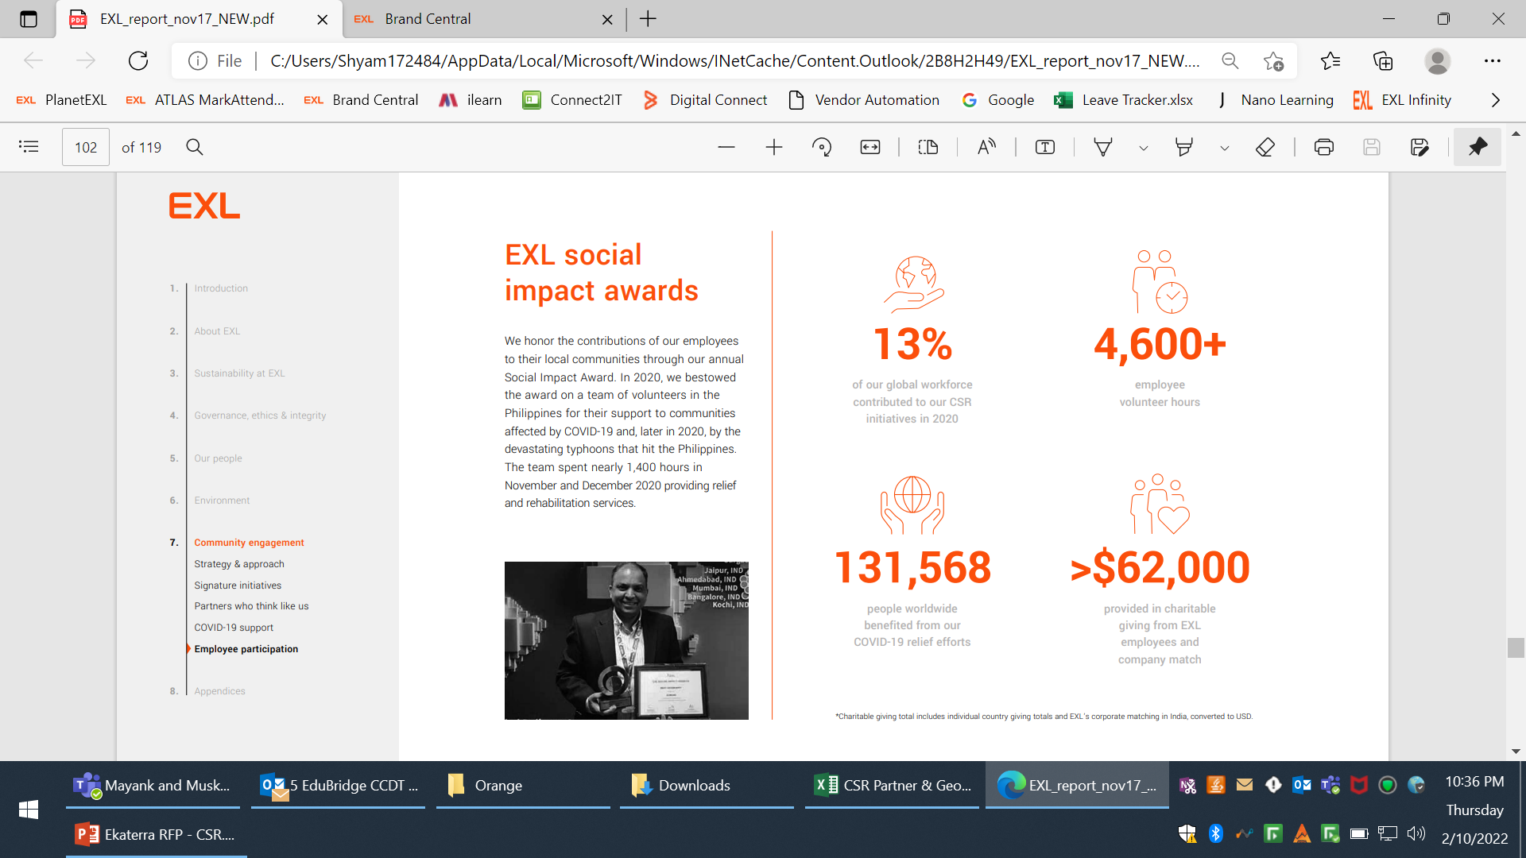
Corporate Social Responsibility
Our corporate social responsibility is driven by the mission of developing market-relevant skills in communities around us.
- Skills is at the core of our strategy because in a data-led world, more than ever, right set of skills are key to the success of an individual.
Through our initiatives, we aim to build the next generation of creators and innovators by introducing and laying a strong foundation of data and analytics skills for students in India, Philippines, South Africa, United Kingdom and United States.
We create and implement initiatives to bridge the skills gap in a digital world for high school students as well as college graduates. EXL and its employees are committed to driving impactful and sustainable social change through engagement with and investment in local communities. Our community engagement strategy includes signature philanthropic partnerships and programs, as well as employee volunteering and employee giving. We are driven by our corporate purpose, always looking deeper to find a better way.
EXL and its employees are also committed to help drive social change. In addition to investing in several initiatives focused on education and market-relevant skill development, in 2021 also participated in several COVID-19-related relief efforts.
13%
4000+
119,000+
>$255K
of our global workforce contributed to our CSR initiative in 2021
employee volunteer hours
people worldwide benefited from our COVID-19 relief efforts
provided in charitable giving from EXL employees and company match

Slide 66
Corporate Social Responsibility
Skills to Win - Developing market-relevant skills
Education as a foundation for market-relevant skills
Our “Skills to Win” initiative seeks to equip individuals with in-demand skills to create better employment opportunities in the communities where we operate. Skills to Win is opening new doors for employment and earnings for participants in the United States, the Philippines, India, United Kingdom and South Africa. Over the past five years, we have continued to evolve this initiative to reflect new and emerging skills and strengthen the portfolio of courses offered.
Our focus
This initiative provides students not only with a foundation in data and analytics skills through formal training sessions, but also extracurricular activities in art, music, fitness, and languages through our employee volunteer initiative. In 2020, we transitioned the initiative to a blend of online and offline learning platforms, expanded the role of our students’ parents as co-educators, and added a new focus in our content on the physical and mental wellbeing of our students and their families.
Case study: Expanding skills to win across India
Case study: Education at scale
Building on our Skills to Win initiative, in 2020 we launched a program to provide training in data, AI, digital technologies, finance, and accounting to underprivileged students in Bengaluru, Noida, Gurugram, Hyderabad, Chennai and Pune, India. Partnering with some of the best training organizations in India, we have co-created a program that began with 600 trainees and is scaled up to training 1,800 students in 2021. The program requires a commitment of three to six months from each participant, resulting in up to 600 hours for each participant. Through the program, we aim to position students for better career opportunities in the digital economy.
Building on our Education as a Foundation initiative in 2020 – we launched a new Education at Scale initiative in India. We enrolled 2,000 students from Noida and Bangalore in 2020; and scaled up enrollment to 7,500 students in 2021 through expansion into Pune, Chennai, Kochi, and Gurgaon.
The initiative is designed to build the students’ life and employability skills, with a focus on language, mathematics, science, and innovation. EXL employees also serve as social champions by volunteering their time to lead virtual sessions in life skills, mental well-being, and digital literacy.

